Slide 1
Linux Kernel
Introduction to
Memory Management
黃偉修

Slide 2
Outline
Virtual memory model
Caches
Page allocation and Deallcation
Swapping Out and Discarding pages

Slide 3
Virtual memory model
Why virtual memory ? . Large address Space . Protection . Shared memory <ex.shell program ,library>
how to virtual memory ? . Page . Linear address transform . Demand paging <see figure>

Slide 4
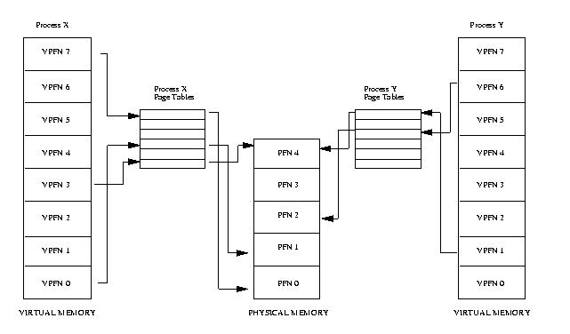

Slide 5
Virtual memory model
Linux Page .There level page Tables <see next figure> . Independent to processor - X86 2-level - Alpha 3-level each platform must provide translation macros that allow the kernel to traverse the page tables for a particular process

Slide 6
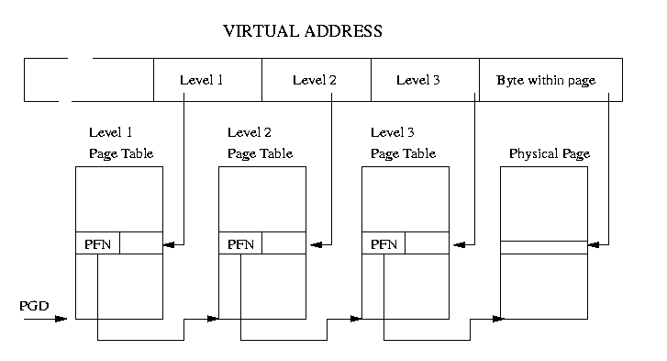

Slide 7
Virtual memory model
Address Transfer . Ex: 386 processor <see next table>
A 32-bit Linear address is divided as follows:
31 ...... 22 21 ...... 12 11 ...... 0
DIR TABLE OFFSET

Slide 8
Physical address is then computed (in hardware) as:
CR3 + DIR points to the table_base.
table_base + TABLE points to the page_base.
physical_address page_base + OFFSET

Slide 9
Format for Page directory and Page table entry:
31 ...... 12 11 .. 9 8 7 6 5 4 3 2 1 0
ADDRESS OS 0 0 D A 0 0 U/S R/W P
D 1 means page is dirty (undefined for page directory entry).
R/W 0 means readonly for user.
U/S 1 means user page.
P 1 means page is present in memory.
A 1 means page has been accessed (set to 0 by aging).
OS bits can be used for LRU etc, and are defined by the OS.
I.e :When a page is swapped, bits 1-31 are used to mark where a page
is stored in swap (bit 0 must be 0).

Slide 10
Virtual memory model
Memory Mapping . The link of an image into a processes virtual address space is known as mapping . Every process virtual memory is represent by an mm_struct data structure - information about image - points to a number of vm_area_struct data struct . Vm_area_struct <see figure and detail>

Slide 11
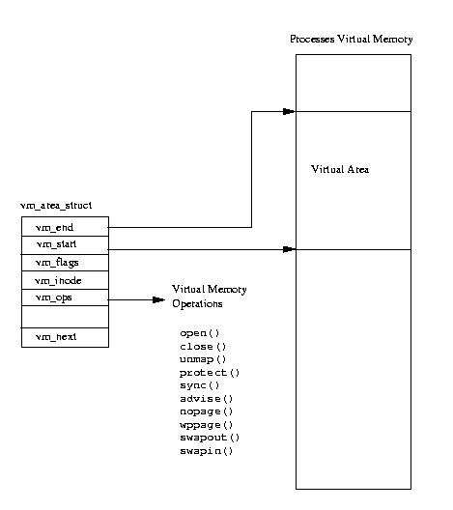

Slide 12
mm_struct
the mm_struct data structure is used to describe the virtual memory of a task or process.
struct mm_struct {
int count;
pgd_t * pgd;
unsigned long context;
unsigned long start_code, end_code, start_data, end_data;
unsigned long start_brk, brk, start_stack, start_mmap;
unsigned long arg_start, arg_end, env_start, env_end;
unsigned long rss, total_vm, locked_vm;
unsigned long def_flags;
struct vm_area_struct * mmap;
struct vm_area_struct * mmap_avl;
struct semaphore mmap_sem;
};

Slide 13
vm_area_struct
Each vm_area_struct data structure describes an area of virtual memory for a process. struct vm_area_struct { struct mm_struct * vm_mm; /* VM area parameters */ unsigned long vm_start; unsigned long vm_end; pgprot_t vm_page_prot; 保護屬性 unsigned short vm_flags; 存取權限和哪些保護屬性可設定
/* AVL tree of VM areas per task, sorted by address */ short vm_avl_height; struct vm_area_struct * vm_avl_left; struct vm_area_struct * vm_avl_right;
/* linked list of VM areas per task, sorted by address */ struct vm_area_struct * vm_next;

Slide 14
/* for areas with inode, the circular list inode->i_mmap */
/* for shm areas, the circular list of attaches */
/* otherwise unused */ struct vm_area_struct * vm_nextt_share; struct vm_area_struct * vm_prev_share;
/* more */ struct vm_operations_struct * vm_ops; 運算函數位址 unsigned long vm_offset; 作memory mapping struct inode * vm_inode; unsigned long vm_pte; /* shared mem */
};

Slide 15
Virtual memory model
Demand paging . Access not valid page table entry . Page fault report address and access type . Search vm_area_struct in a AVL tree to check illegal or legal virtual address (send SIGSEGV signal to process) . If legal virtual address then check type . Else the page fault is legal case note: differentiate between swap file and somewhere on disk

Slide 16
Virtual memory model
How about O.S ? . Physical mode V.S Virtual addressing mode . Physical mode : no page tables / addr transfer . Linux OS run in physical mode

Slide 17
Caches
Buffer Cache . the buffer cache is indexed via the device identifier and desire block number
Page Cache . Used to speed up access to images and data on disk . Bring page not through file system . Page read ahead

Slide 18
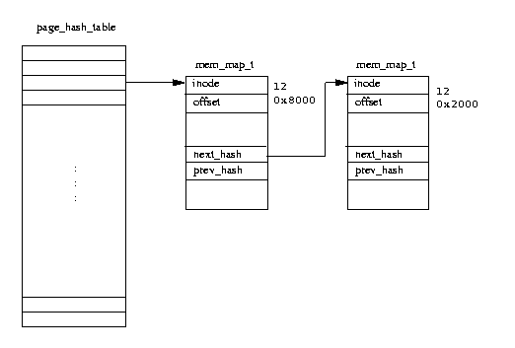

Slide 19
Caches
Swap Cache . Only dirty pages are saved in swap file . no need to write it to the swap file if the page is already in the swap file

Slide 20
Caches
Hardware Caches .TLB . To avoid three times of memory reference

Slide 21
Page Allocation and Deallocation
Some data structure . Mem_map - all of physical pages in system are described by - a list of mem_map_t . Mem_map_t - describes a single physical page in system - field : count ->number of used the page age map_nr ->physical frame number

Slide 22
Page Allocation and Deallocation
Some data structure . free _area vector - each element contains information about “block” of page - the block size upwards in power of two i.e. Free_area[0]=1 page per block Free_area[0]=2 page per block Free_area[0]=4 page per block <see figure>

Slide 23
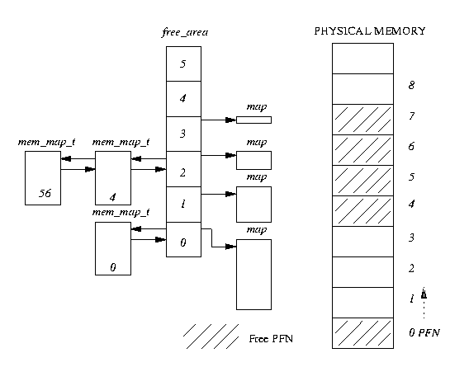
bit N is set if the N’th block is free
Map is a point to bitmap to which keeps to track of allocated groups of page of this size

Slide 24
Page Allocation and Deallocation
Buddy algorithm .Allocation - allocation code search free_area for requested size - follow the chain and check the map to find the free block - if no free block , search the twice size chain - break down this block ,then free blocks are queue on appropriate queue <ex: request 2 pages>

Slide 25
Page Allocation and Deallocation
Buddy al gorithm .Deallocation - whenever a block of pages is freed ,the adjacent or buddy block of same size is checked to see if free . - if free then recombine into a bigger block free size. <ex frame 1 to be free >

Slide 26
Page Allocation and Deallocation
Buddy al gorithm . .Conclude allocation tends to fragment memory to ”small” one deallocation tends to recombines pages into “bigger” one

Slide 27
Swapping Out and Discarding pages
Kernel swap daemon (kswapd) . a special type of process,a kernel thread . Make sure that there enough pages in physical memory . Waiting for the kernel swap “timer” to periodically expire . Two scale : free_pages_high , free_page_low

Slide 28
Swapping Out and Discarding pages
when to do ? .num of free pages fallen below free_page_high worse still free_page_low - below free_page_high ->swap free 3 pages - below free_page_low ->swap free 6 page .Timer

Slide 29
Swapping Out and Discarding pages
Method .reducing the size of the buffer and page cache - discarding these pages dose not have too many harmful side effect because “caches”!! - check mem_map to see if some page is cached - shared pages are not considered and page can’t in both cache - if not enough cached page then consider shared page
Method . Swapping Out System V shared Memory pages

Slide 30
Swapping Out and Discarding pages
Method .swapping out and discarding pages - look at each “process” in the system in turn to see if it is a good candidate for swapping - not swap or discard “shared” or “locked” page - not swap out all of the swappable pages of the process - decide by “age” in the mem_map_t (old)

Slide 31
Swapping Out and Discarding pages
Method . Swapping Out System V shared Memory pages i.e. kswapd remember which method that it used last time successfully

